Slide 1
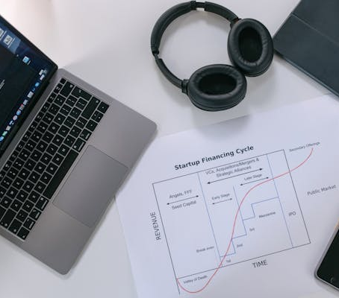
Consumer Good Ad-Hoc Insights
Created By: Mohd Waqas

Slide 2
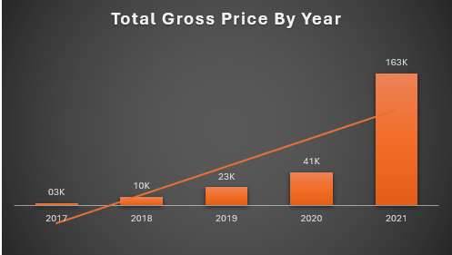
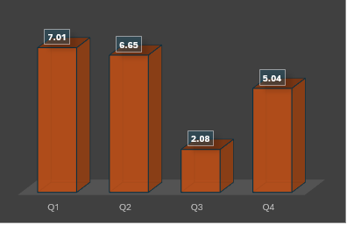
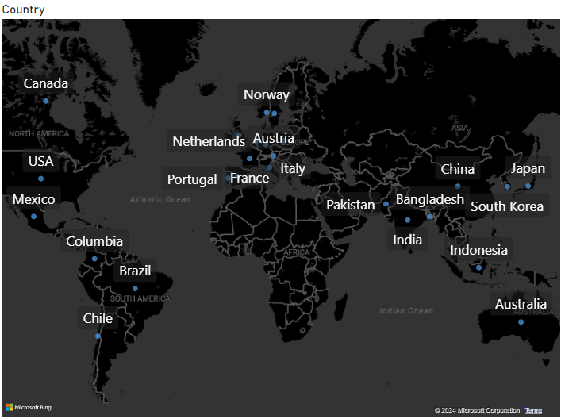

Atlanta, a rapidly expanding hardware company, offers a range of products to customers across numerous countries through multiple channels, including retail, direct sales, and distribution networks, both online and in physical stores. To fuel its growth and make informed, data-driven decisions, AtliQ requires a dedicated data analytics team.
INTRODUCTION
DATE & REQUESTS
AD_HOC REQUEST
INSIGHT
TOOL USED

Slide 3

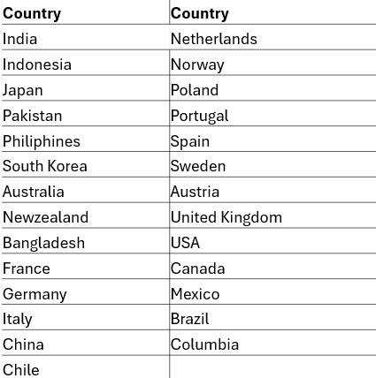
Request 1: Provide the list of country where company is having a business.

Slide 4
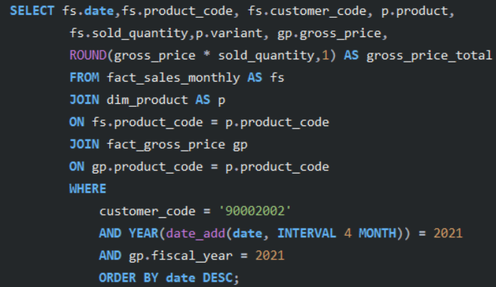
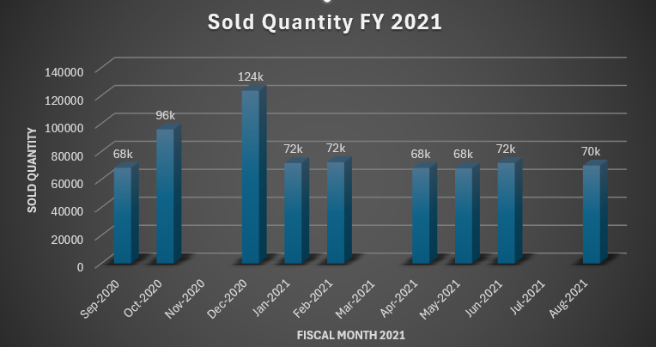
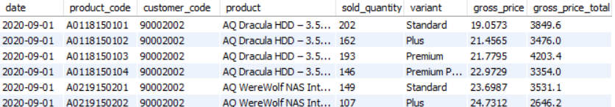
Request 2: Generate a report of individual product sales from Croma India customer for FY = 2021 so that stakeholder can track individual product sales.

Slide 5
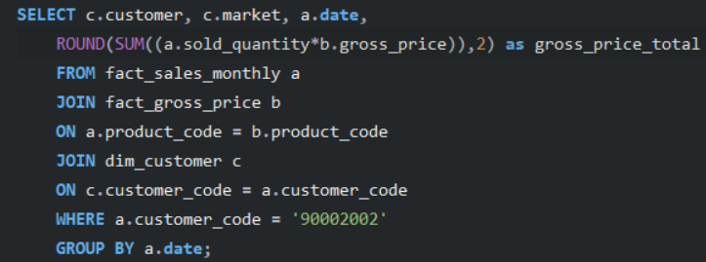
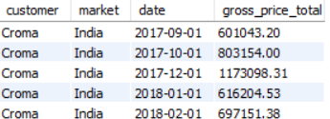
Request 3: Generate a report of an aggregate monthly gross sales for Croma India customer to track how much sales this particular customer is generating for AtliQ and manage relationships.

Slide 6
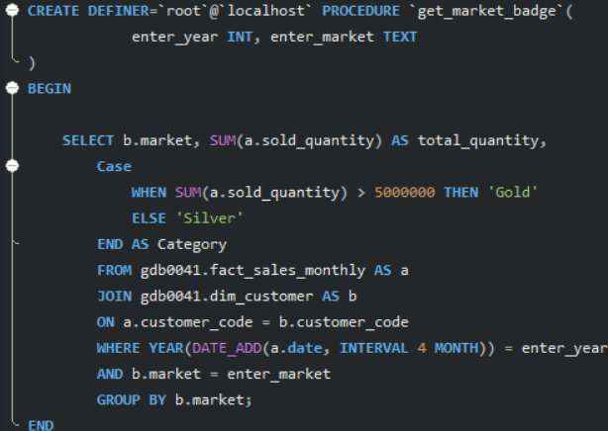
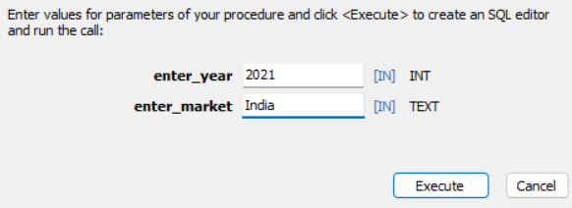

Request 4: Create a stored procedure that can determine the market badge based on the follow logic. If sod quantity > 50 million consider it 'Gold' else 'Silver'. INPUT 1. Market 2. Fiscal year

Slide 7
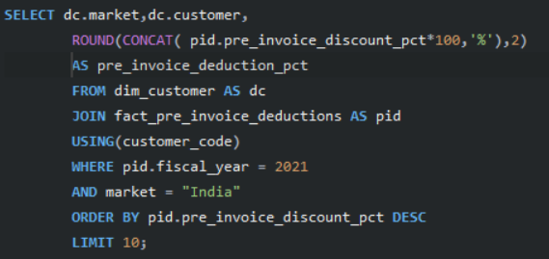
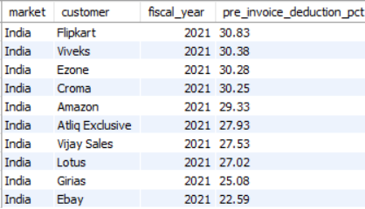
Request 5: Provide the list of top 10 customers in India getting highest pre invoice discount in financial year 2021.

Slide 8
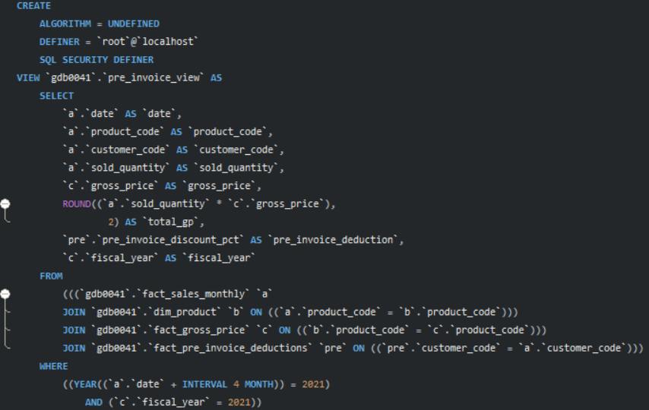
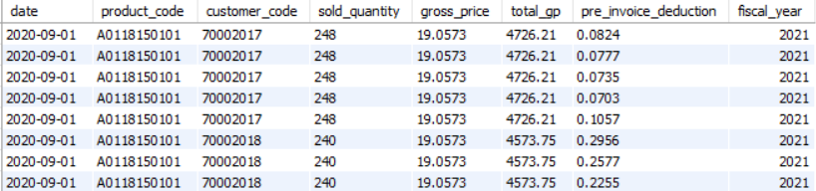
Request 6: Find the net sales for the fiscal_year 2021
Getting Pre invoice deduction and storing as view

Slide 9
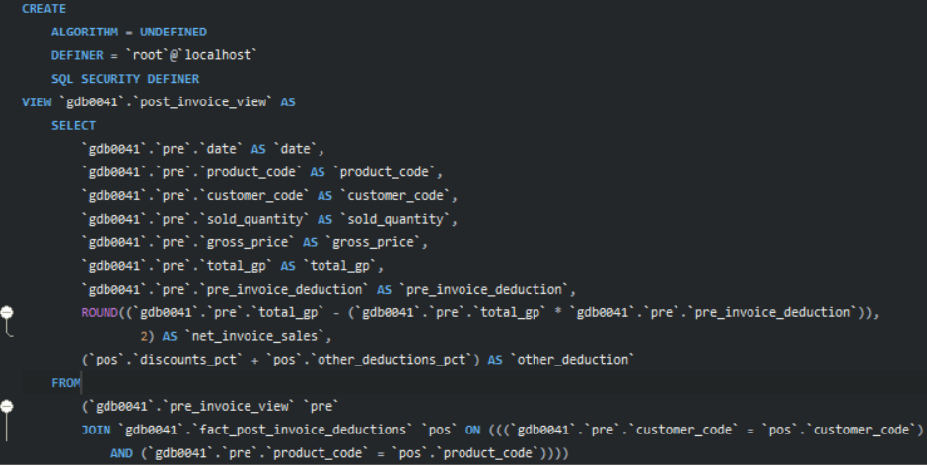
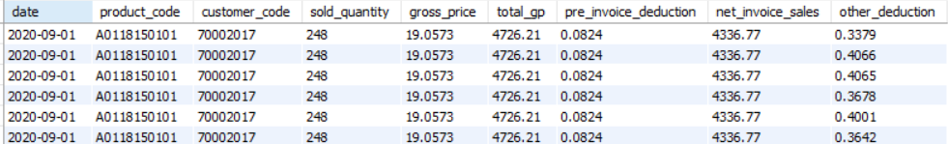
Getting Post invoice deduction and storing as view

Slide 10
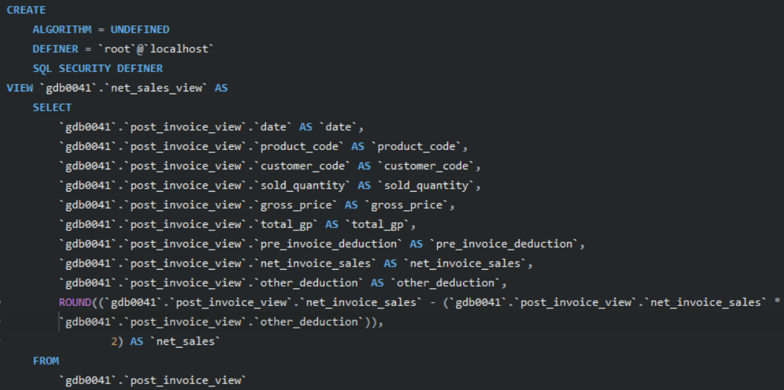
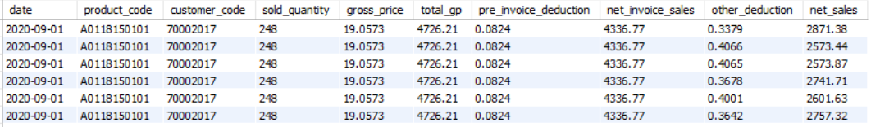
Getting net sales and storing as view

Slide 11
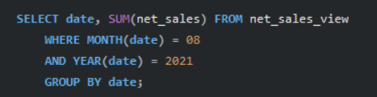

7. Get total net sales for the months of August_2021.

Slide 12
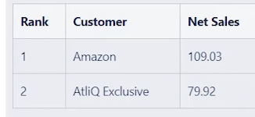
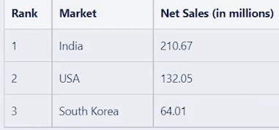
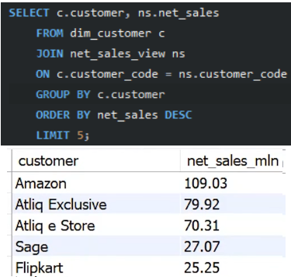
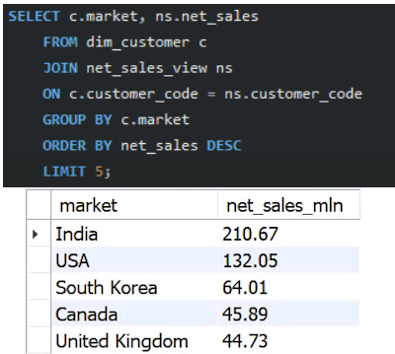
8. Find top customer by net sales
8. Find top markets by net sales

Slide 13
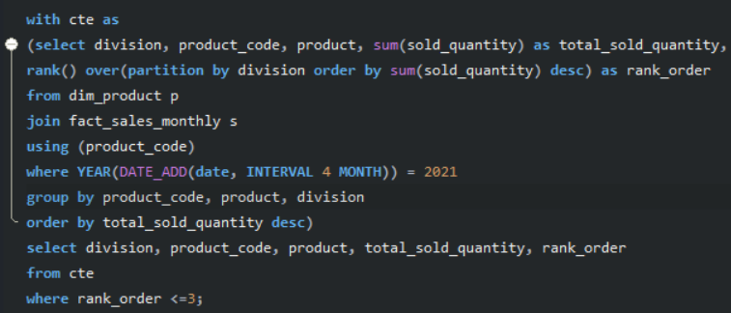
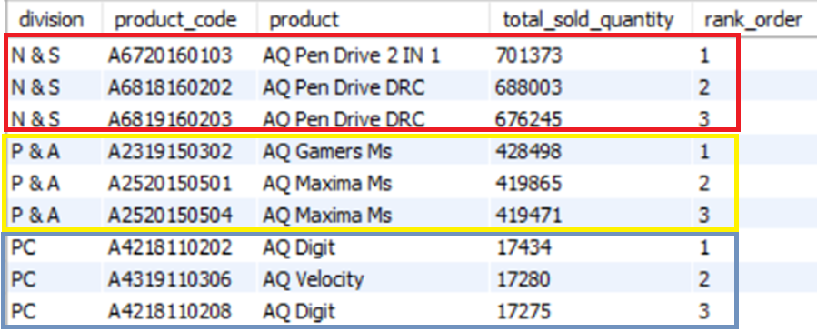
Request 9: Get the Top 3 products in each division that have a high total sold quantity in the fiscal year 2021? The final output contains these fields: division, product code, product, total sold quantity, rank order.

Slide 14
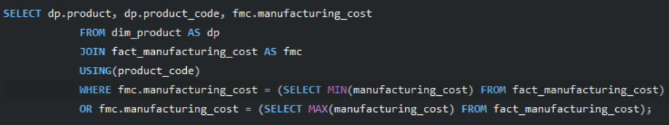

Request 10: Get the products that have the highest and lowest manufacturing costs. The final output should contain these fields: product code, product, manufacturing cost.

Slide 15
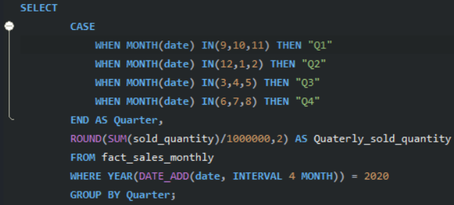
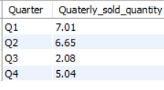
Request 11: Find the quarter in 2020 having maximum sold quantity

Slide 16


Thankyou

